Slide 1
A 3DIC system to aid in the acceleration of systems that employ multiple instances of artificial neural networks
Final oral exam: Lee B. Baker
Date: 28th February 2018
PhD Committee:
Dr. W. Alexander, Dr. G. Byrd,
Dr. P. Franzon(Chair), Dr. R. Warr

Slide 2
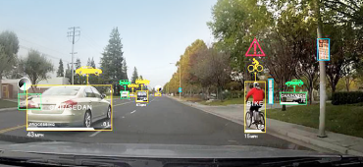

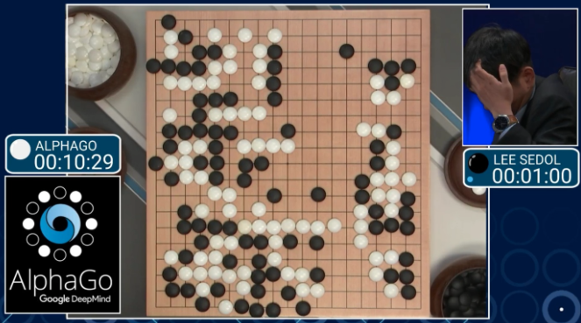
Introduction
Recently Artificial Neural networks (NN) have demonstrated superior performance in classification and function approximation
Deep Neural Networks (DNN) have been very successful in image processing applications ^{[Kri12]}
it is anticipated that DNNs will be employed more and more in self-driving cars
http://www.hackerboards.com
http://www.BGR.com
Reinforcement learning is gaining popularity
alphaGo employed reinforcement learning with deep neural networks ^{[Mad14]}
http://www.engadget.com
Notes:
I suspect most of us have heard of ANNs and their use in applications such as self-driving cars.
The ability for artificial neural networks to perform that function in a timely fashion within reasonable power and space constraints is what I am going to talk about today.
I am going to present a system that is able to accelerate multiple instances of disparate useful sized artificial neural networks and provide power and/or area benefits over current state-of-the-art

Slide 3
Introduction
What about applications that will and do require multiple NN processors running at or near real-time?
drone scanning in many directions during navigation
looking down different than looking forward??
aircraft performing system diagnostics during flight
observing thermal profiles
observing vibrations
airport security
face recognition
body thermal profiles
motion
Notes:
If ANNs fulfill their potential they will be employed in embedded applications performing various system tasks that need to be processed at or near real time.
So these embedded systems will require multiple disparate ANNs to be running concurrently.

Slide 4
Introduction
Most useful ANNs are big
100’s of thousands of artificial neurons
real-time processing requires large amounts of memory bandwidth and storage
DRAM is required
Most implementations employ SRAM for local memory
from [27]
Notes:
Most ANNs are big and the trend is that they are becoming larger and deeper
There is general acceptance that DRAM needs to be used to stored the ANN parameters
But many implementations have focused on using SRAM as an intermediate store to isolate the system from the slower DRAM.
Now this has proved to be very effective when there are reuse opportunities where the SRAM can be loaded from DRAM then accessed multiple times before having to go back to the slower DRAM.
The main reuse opportunities come in the form of shared parameters and batch processing.
Batch processing occurs when multiple requests are made to the same ANN, such as in cloud application.
Parameter reuse occurs when the same connection weights are used at different locations of the ANN

Slide 5
ANN Types
Convolutional neural networks
shared filter kernel allows reuse
classifier stages are fully-connected – no reuse
non-shared kernels – no reuse ^{[42][27]}
from [27]
Notes:
First, we are considering embedded systems that will not have batch processing opportunities
We will have reuse in the form of shared parameters in Convolutional NNs where the same feature kernels are applied across the input.
But reuse isn’t available when we have CNNs with non-shared kernels

Slide 6
ANN Types
DNNs and LSTM
fully-connected - no reuse
classifier stage in CNNs
from [27]
Notes:
There are other types of ANNs that do not provide reuse opportunities such as and fully-connected DNNs such as LSTM.
Our mission is to be able to support all types of ANNs
So the embedded application's we are targeting have the potential to expose the limitations of these SRAM-based implementations

Slide 7
Research
Most research focused on CNNs
can take advantage of SRAM using parameter reuse
A lot of focus on server applications
perhaps lots of research $$ available??
server applications can take advantage of SRAM for batch processing
But many DNNs are fully-connected [1]
LSTM and MLPs
classifier stage of all ANNs including CNN
CNNs represented only 5% of cloud workload [1]

Slide 8
Mission Statement
Real world embedded applications will require multiple disparate NNs to be solved simultaneously
If ANNs fulfill their potential, they will be used for various system functions
Need the capacity provided by DRAM
Avoid dependency on SRAM
SRAM is easy to use, but capacity limitations impose ANN size restrictions.
Need to consider the system impact
Research often focuses on point problems. Need to consider interaction between blocks.
Notes:
During the creation of this works system, when I had the urge to add SRAM because it made things easier, I forced myself to think how I could solve it with just the DRAM
This work is proposing using 3DIC technology, and in this case I felt it was important to also get a very good feel for the area associated with such a system

Slide 9
Problem
Many embedded applications will/do have power, space and weight limitations
to achieve near or at real-time processing, current solutions require high power and high real-estate
GPU solutions large and high power
ASIC’s better than GPUs
Both have memory bandwidth or capacity limitations when reuse opportunities do not exist
Notes:
Current implementations typically employ graphics processors or application specific integrated circuits.
GPU solutions have large real-estate and power requirements
ASIC’s on the other hand can be designed to efficiently perform the ANN processing but they typically target smaller network sizes and/or specific NN’s
So there isn't currently a solution out there that can support processing multiple ANN’s in real time within reasonable power and size constraints.

Slide 10
Solution
3DIC Architecture
reduces energy and area
increase connectivity and bandwidth
3D-DRAM
provide high bandwidth and large storage
operate directly out of DRAM
Data Structures
data structures to ensure neural network data can be accessed efficiency
Specialized processing layers
provide special functions to aid in acceleration of target neural networks
Notes:
This work proposes taking advantage of 3D IC technology.
This 3D architecture will include a custom organized 3D DRAM to store the neural network and Data structures designed to access that DRAM effectively.
The proposal also includes custom processing layers to perform the NN computations.
Using DRAM addresses the large network size requirement
and the 3D architecture ensures we can address bandwidth, space and power issues.
The custom processing layers will be targeted toward a family of ANN’s

Slide 11
Feasibility
Can a 3D-DRAM be used effectively?
Can a useful system fit within the 3D stack footprint?
How can we control such a system?
Notes:
The primary contributions of this work is
- a custom organized 3DIC DRAM allowing us to provide the necessary memory bandwidth to process multiple ANN’s in real time
- data structures for storing parameters and neuron activation values
- a 3D architecture which will ensure the bandwidth provided by the custom memory can be processed at line rate by a processing layer customized to the functions required to process the target ANN’s
Combining these contributions will allow us to demonstrate a significant performance improvement overcurrent solutions

Slide 12
Contribution
An extensible architecture that can simultaneously process multiple disparate real-time DNNs
Proposed a custom 3D-DRAM providing a ~32X bandwidth benefit compared to standard 3D-DRAM
A DNN system solution that employs pure 3DIC technology
Custom instructions and data structures that facilitate operating directly out of 3D-DRAM

Slide 13
Outline
What are artificial Neural networks
Target application and ANN type’s
State-of-the-art
System Architecture
Problem
Solution
System details
3DIC DRAM and data structures
3D Bus
Manager
Processing engine
Results
Summary

Slide 14
Artificial Neural Networks
a network of processing elements inspired by the connectivity and processing observed in the brain
[7][34]
[7][34]
the processing elements or neurons are connected together to form a network
[7][34]
Notes:
Neural networks are a mathematical model, but they are advertised as being inspired by neurons in the brain.
Mention this is the basic neuron model used is almost all ANN’s
Mention it has been well understood that when organized like this a network of ANN’s can be used to solve complex functions and classifiers
The terminology used is the neuron being considered is the post synaptic neuron when they are linear function approximators

Slide 15
Artificial Neural Networks
the processing elements fall into two categories
rate based^{[7][34]} neurons which try to capture the neuron behavior in the form of a number
relatively simple to model
easier to train and have shown high levels of efficacy in many applications
spiking neurons^{[7][34]} which more closely emulate actual brain behavior
model neural activity in the form of differential equations
require numerical methods to solve although there have been attempts to employ analog circuits
In this work we are focusing on rate based ANNs
Notes:
Keep this concise
Real neurons generate spikes
Believed that information is carried in spike rates
Rate coding is a simplification
Rate-based neural network used when we see demonstrations from google etc.
Spiking considered more powerful

Slide 16
Summary : Target application and ANN type’s
Embedded systems
not cloud based
assumes multiple tasks are being performed
requires multiple disparate ANNs
inference only
This work has focused on support for:
fully- and locally-connected DNNs
can be extended to support LSTMs
Notes:
DNN classifiers because of their performance in image recognition
ANN in reinforcement learning because of their use as value function approximator
and finally Cogent Confabulation and BsB because of their joint efficacy in a text recognition system

Slide 17
State-of-the-art
Current implementations either use GPU’s or low capacity ASIC implementations
GPU’s are typically general purpose devices and consume high power
GPU’s do lend themselves to convolution when weights are shared
ASICs almost always provide performance improvements
ASIC implementations target larger networks by using multiple devices
usually assume local SRAM which limits network size
some/most implementations target specific NN’s, usually CNNs

Slide 18
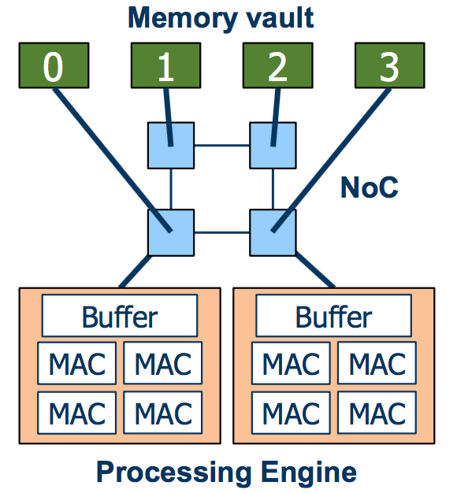
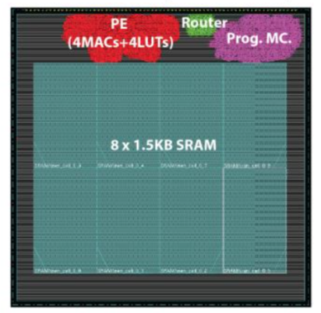
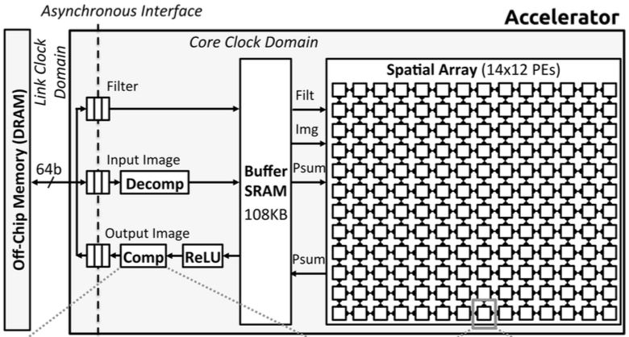
State of the Art ASIC’s
ASIC’s
NeuroCube^{[24]}
Eyeriss^{[11]}

Slide 19
State of the Art ASIC’s
NeuroStream^{[3]}
acknowledges DRAM is required for useful DNNs
uses HBM 3D-DRAM along with local SRAM
depends on SRAM for performance
Google TPU^{[1]}
assumes large levels of batch processing
8-bit processing
fully-connected NNs represent very high percentage
acknowledges performance degradation using fully-connected
DaDiannao^{[10]}
uses embedded DRAM but still requires up to 64 for useful DNNs
high internal bandwidth but dissipates high power when scaling to useful-sized ANNs
Notes:
Mention focus on more recent devices

Slide 20
State of the Art
Current state-of-the art ASIC’s and GPU’s do not provide the capacity and bandwidth to provide a solution requiring multiple useful disparate ANN’s to be computed in real-time
Goldilocks principle
need balance of bandwidth and storage
need to read all parameters in sample time for real-time processing
Currently SOA bandwidth too low or too high

Slide 21
System Requirements
System solution requiring multiple NN’s
~8GB of memory for baseline ANN
real-time processing : ~16mS (60 frames/sec)
~26Tbps memory bandwidth for baseline ANN
Current 3D-DRAM memory technology bandwidth
HMC – SERDES~2Tbps – too low
HBM – wide DDR ~2Tbps – too low
Tezzaron DiRAM4^{[14]} – wide DDR – 4Tbps – too low
Propose Customized DiRAM4
expose more of the page
take advantage of high density TSVs

Slide 22
Architecture Blocks
Proposed Customizations to standard DiRAM4 3D-DRAM
Data Structures and Instructions to support efficient use of DRAM
Management Layer for configuration and control
DRAM controller
Instruction decoder
Processing layer targeted toward DNNs
streaming functions operate directly on data
multiply/accumulates ANe activation
multiply for softmax
additional special functions in SIMD used in the neuron activation process
ReLu for ANe activation
add, divide and exponent for softmax function
compare for pooling
Notes:
Mention multiported
Memory layers, control layer and processing layer could use different technology
SSF’s will operate directly on data read from stack bus
To increase bus widths, increase bandwidth while minimizing interface power
provide access to entire page rather than cache-line
there will be power considerations by not taking advantage of some reuse of data in local memory but I believe the performance benefits will outweigh the disadvantages
Special streaming functions will also have the ability to operate on data in processing layers expected small amount of local memory
avoid DRAM page open latency by using a highly banked DRAM and arranging data in memory to allow back-to-back page opens
Careful consideration of layer state and kernel parameters required to maximize DRAM bandwidth

Slide 23
Main memory
The 3D-DRAM is the Tezzaron DiRAM4
64 disjoint 1Gb memory ports
System has 64 sub-systems each operating on one memory port
Suggested Customizations for a 3D-DRAM
Standard DiRAM4 port is 32bits @ 1GHz
We suggest widen to 2048 bits and use high-density TSVs
Entire page in one access using burst-of-2
Raw bandwidth ~2Tbps per port

Slide 24
System Solution
System has 64 sub-systems (SSC) each operating on one memory port
ANNs split over sub-systems
SSCs communicate over local NoC in each Manager
Sub-system (SSC) has a Manager and PE
Instruction Decode in Manager
contains information on how to process a group of ANes
Wide Data-path between DRAM, Manager and PE
data for 32 execution lanes with two arguments per lane
PE performs ANe state operations
process a group of ANes
able to perform a MAC operation between a weight and ANe state every cycle
Notes:
able to process a group of 32 ANes each instruction
return data contains up to 32 words
where are weights, ANe states and result stored

Slide 25
3D Physical Configuration
Customized
3D-DRAM
Management
layer
Processing engine
(PE) layer

Slide 26
Sub-System Column (SSC)
Consists of DRAM, manager and processing engine (PE)
physical
logical

Slide 27
Solution Block Diagram
Total downstream B/W
64Tbps
Processing engine layer
(PE)
Customized DRAM
Management Layer

Slide 28
System Connectivity
Customized
DRAM
Management Layer
Processing engine layer
(PE)

Slide 29
Architecture Requirements
Need to absorb DRAM latency
separate memory requests from read/write data
Instruction spawns multiple commands to dependent tasks
concurrently pre-fetch data, prepare PE, prepare Return Data Processor
all operations have an associated tag
Need to describe parameter and state storage
assume input stored in row-major fashion
Network-on-Chip
needed for ANe state replication to all dependent SSCs

Slide 30
Instructions
Instructions consist of descriptors
Descriptors used to control modules which take part in the instruction
Descriptors contain tuples which contain the details

Slide 31
Instruction Decode
Two types of instruction
Configuration
Compute
Manager sends descriptors to dependent block(s)
may not parse descriptor if not relevant to manager
manager knows descriptor dependencies and sends to modules participating in instruction
Configuration Instruction
send descriptor to manager control block
used for synchronization and data transfers
Compute Operation
send descriptor(s) to blocks participating in ANe state computation
OP
send descriptor to PE
Memory Read
identify target execution lane and send descriptor to one of two memory read controller
Memory Write
send descriptor to return data processor

Slide 32
Compute Instruction

Slide 33
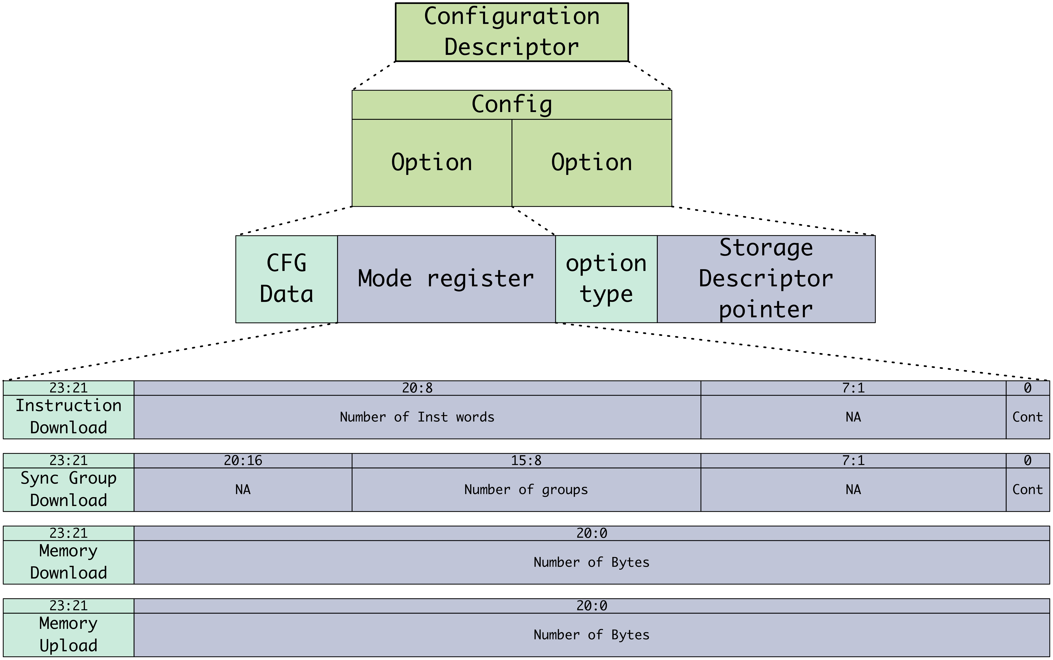
Configuration
Supports both synchronization and data transfer

Slide 34
Data Storage and access
Inputs and ANe states stored in row-major
two address increment mechanisms
Weights for a group of ANes are interleaved

Slide 35
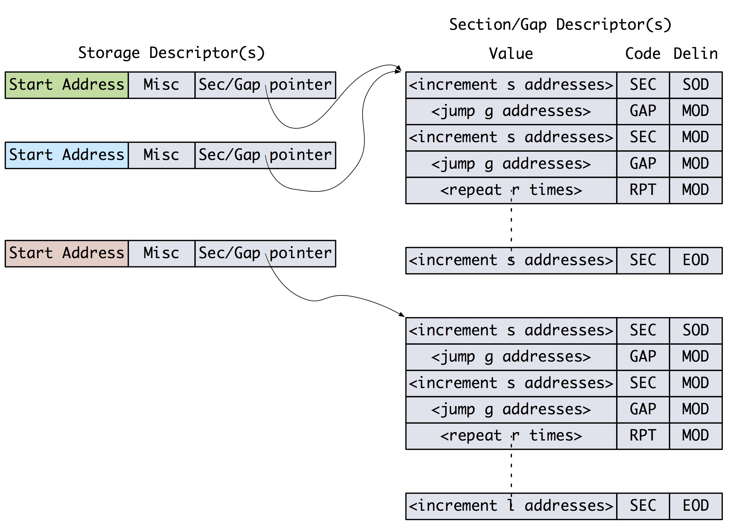
Storage descriptors
Used to describe how data is read/written
Used for both parameter and ANe state storage
instruction contains pointer to storage descriptor
each SSC has a set of storage descriptors
instruction/NoC carry pointer, not address, length etc.

Slide 36
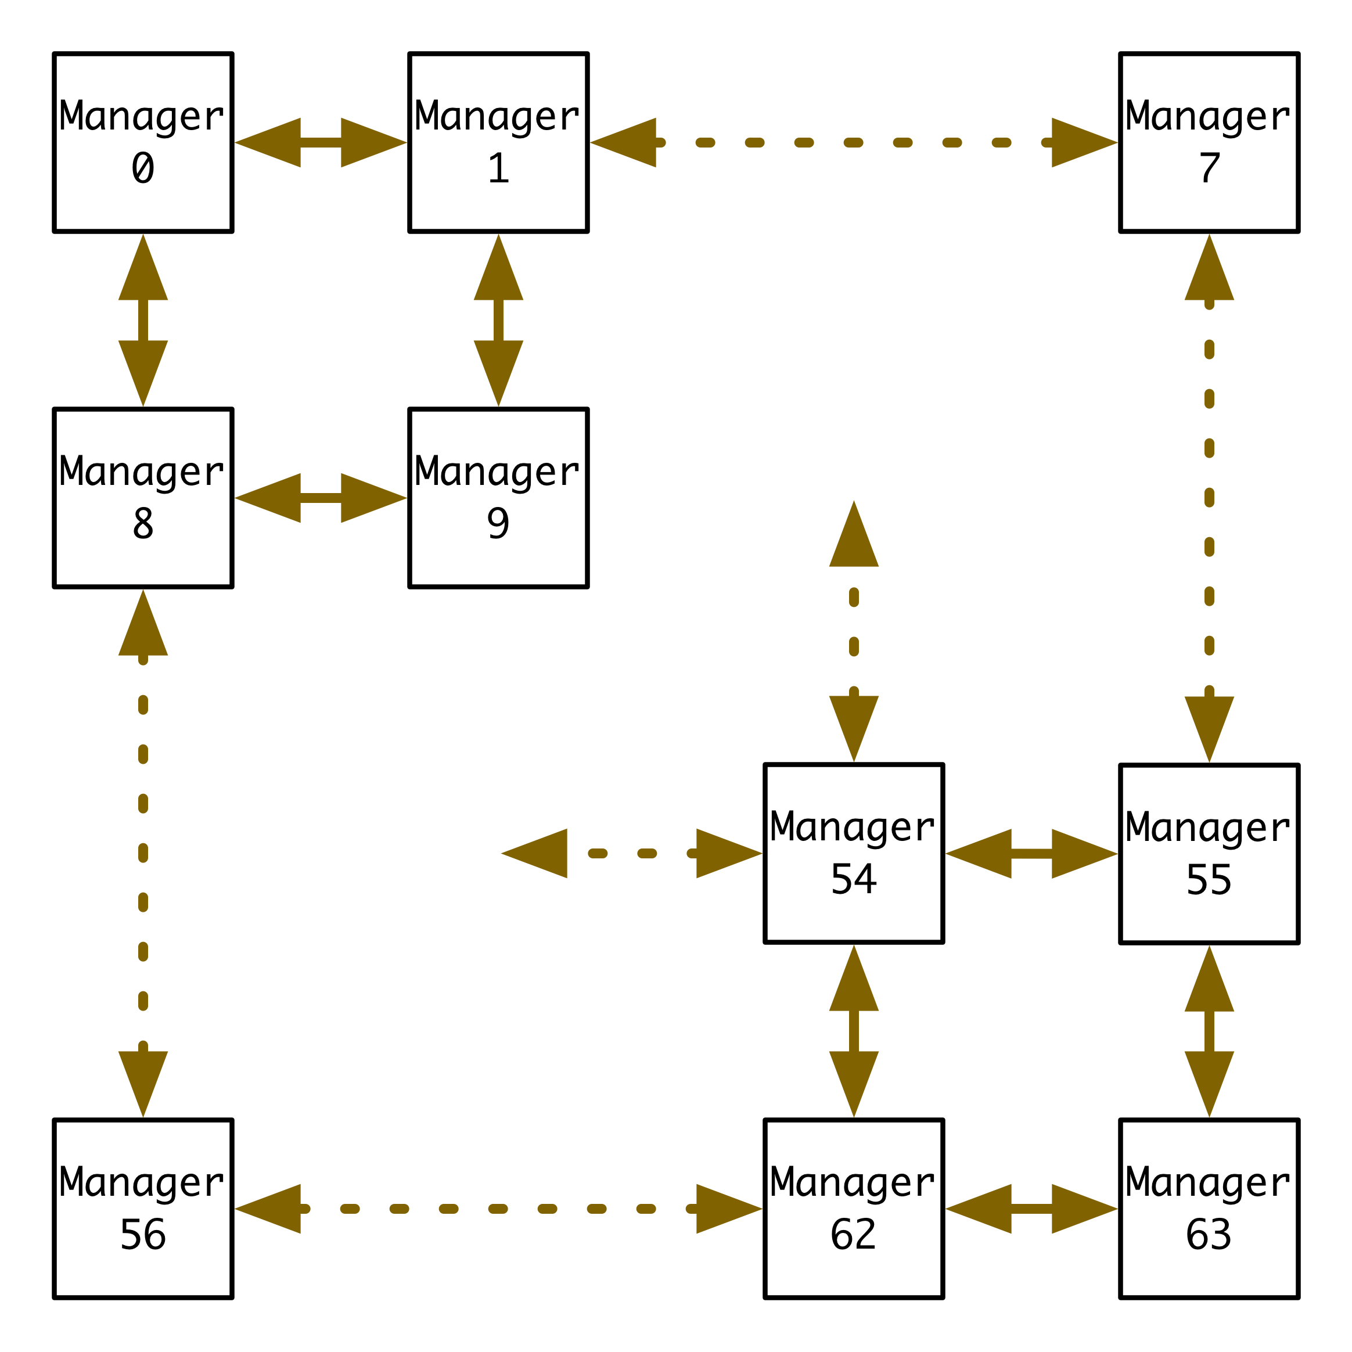
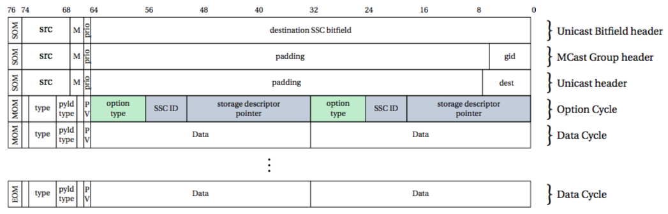
NoC
Four ports
connections to adjacent SSC
fixed routing table
can be reconfigured based on performance
good area for additional research

Slide 37
Manager Layer
Decodes instructions
sub-descriptors are sent to dependent blocks
Reads and writes to main memory
Communicates to host and other SSCs
NoC
Return Data
processor
Data
from
PE
Main
Controller
Memory Write
Decode
OOB
Memory read
Data
To
PE
Notes:
StreamingOps can also designed to operate on data from registers (or small local memory)
many ANN’s share a common kernel (CNNs) or operate on same input ROI
in some cases, storing the kernel or ROI in local memory may avoid unnecessary DRAM reads and IO energy
first convolution could be performed on kernel streamed from DRAM and further convolutions use local memory for one of the arguments
on PE the objective will be to maintain low ratio of local memory to processing
May consider small cache on Controller layer although this will still consume Stack bus TSV power

Slide 38
Manager Layer
Decodes instructions
sub-descriptors are sent to dependent blocks
Reads and writes to main memory
Communicates to host and other SSCs
Notes:
StreamingOps can also designed to operate on data from registers (or small local memory)
many ANN’s share a common kernel (CNNs) or operate on same input ROI
in some cases, storing the kernel or ROI in local memory may avoid unnecessary DRAM reads and IO energy
first convolution could be performed on kernel streamed from DRAM and further convolutions use local memory for one of the arguments
on PE the objective will be to maintain low ratio of local memory to processing
May consider small cache on Controller layer although this will still consume Stack bus TSV power

Slide 39
DRAM Customizations
Expose more of the page
Each burst-of-2 read transfers entire page
Need to accommodate idle time during Page Close
Employ TSVs for wide bus
Provide write masks
To avoid Read-Modify-Write
^{[13]}
Customize
Access
^{[13]}
Notes:
StreamingOps can also designed to operate on data from registers (or small local memory)
many ANN’s share a common kernel (CNNs) or operate on same input ROI
in some cases, storing the kernel or ROI in local memory may avoid unnecessary DRAM reads and IO energy
first convolution could be performed on kernel streamed from DRAM and further convolutions use local memory for one of the arguments
on PE the objective will be to maintain low ratio of local memory to processing
May consider small cache on Controller layer although this will still consume Stack bus TSV power

Slide 40
DRAM Customizations
Expose more of the page
Each burst-of-2 read transfers entire page
Need to accommodate idle time during Page Close
Employ TSVs for wide bus
Provide write masks
To avoid Read-Modify-Write
Notes:
StreamingOps can also designed to operate on data from registers (or small local memory)
many ANN’s share a common kernel (CNNs) or operate on same input ROI
in some cases, storing the kernel or ROI in local memory may avoid unnecessary DRAM reads and IO energy
first convolution could be performed on kernel streamed from DRAM and further convolutions use local memory for one of the arguments
on PE the objective will be to maintain low ratio of local memory to processing
May consider small cache on Controller layer although this will still consume Stack bus TSV power

Slide 41
Processing (PE) Layer
Streaming operations operate directly on data
SIMD Wrapper performs post stOp tasks
ReLu
Add
Divide
Exponent
Compare
Data
to
Mgr
Return
Data
SIMD
Special
Functions
PE
Controller
SIMD
Data
from
Mgr
Streaming
Operations
MAC or Multiply
Notes:
StreamingOps
MAC, Multiply
SIMD Wrapper
add/divide/exponent/compare

Slide 42
Processing (PE) Layer
Streaming operations operate directly on data
SIMD Wrapper performs post stOp tasks
Notes:
StreamingOps
MAC, Multiply
SIMD Wrapper
add/divide/exponent/compare

Slide 43
Detailed Block Diagram
Manager
PE
D
R
A
M

Slide 44
Detailed Block Diagram

Slide 45
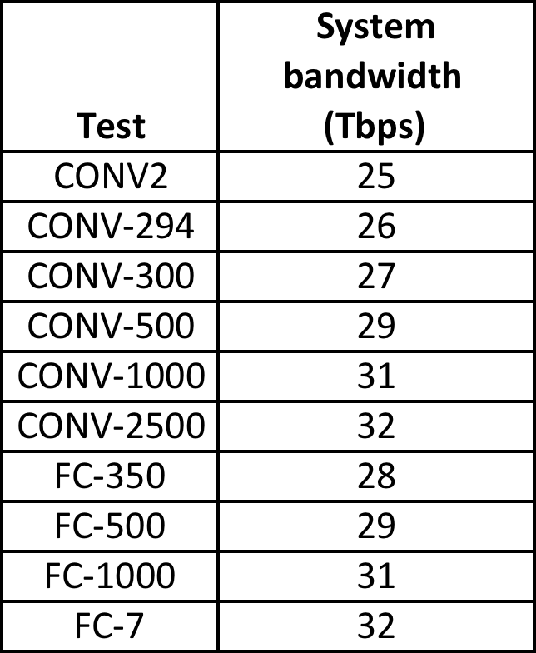
Test Performance
Tested against multiple fan-ins
[27]
[27]

Slide 46
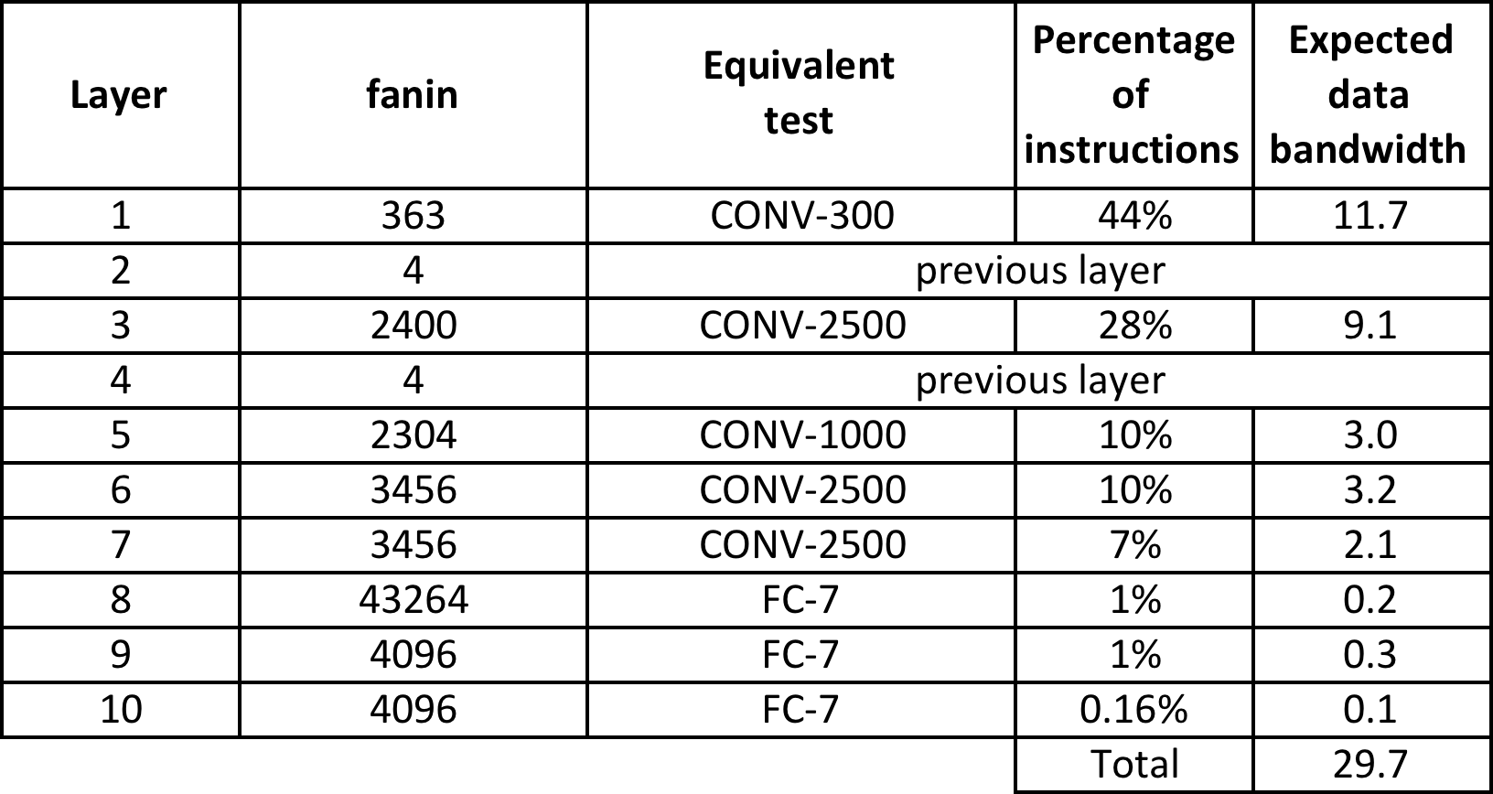
Baseline ANN Performance

Slide 47
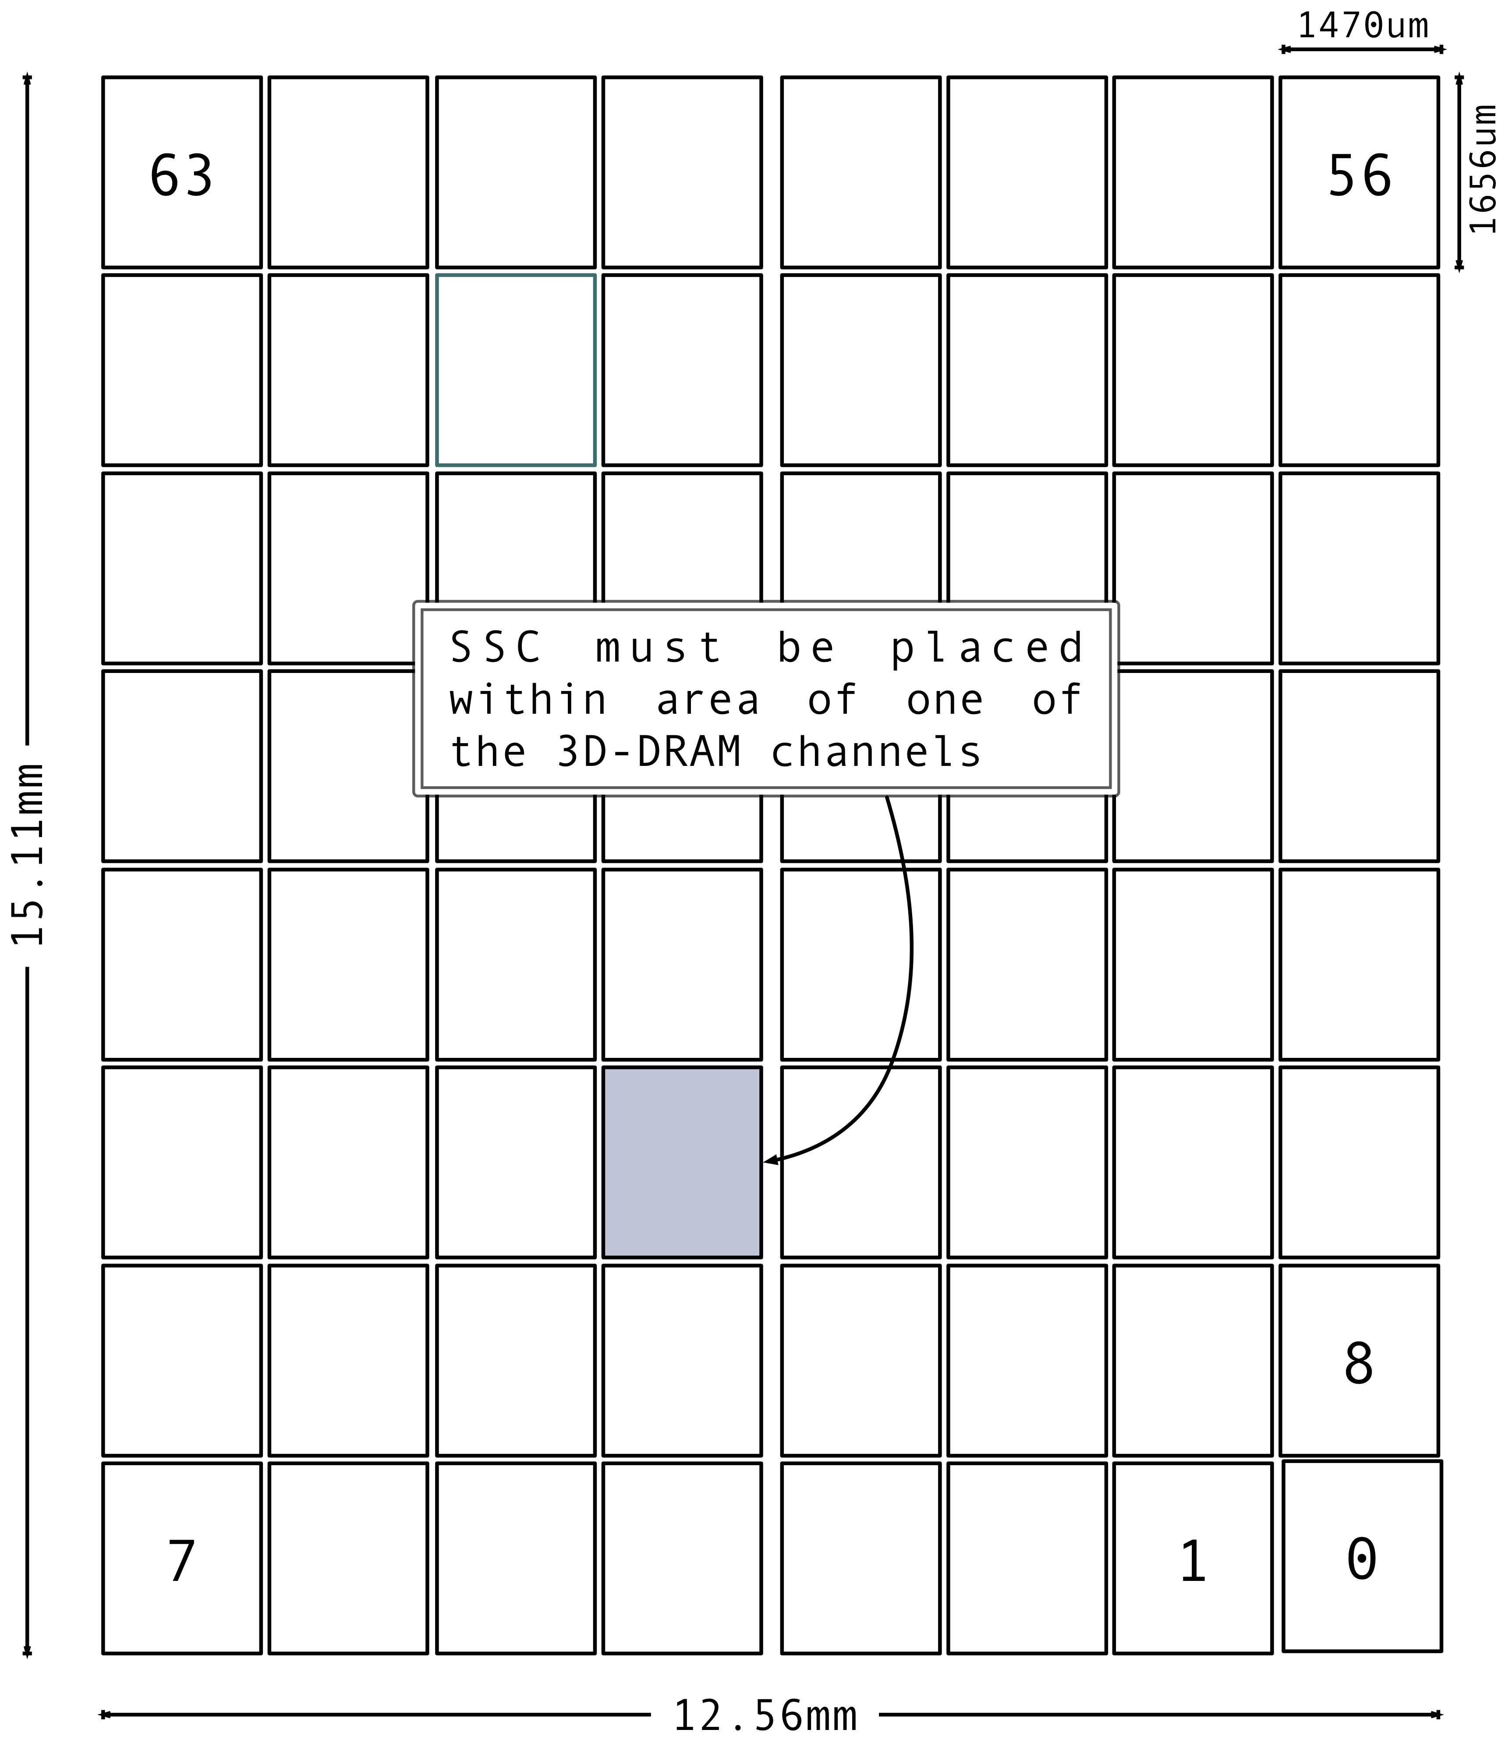
AREA
Area based on DiRAM4
SSC needs to fit into footprint of DiRAM4 sub-memory
available area is 2.43 sq-mm

Slide 48
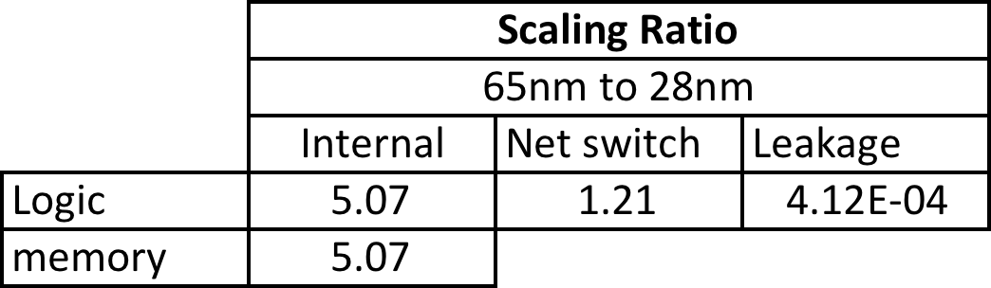
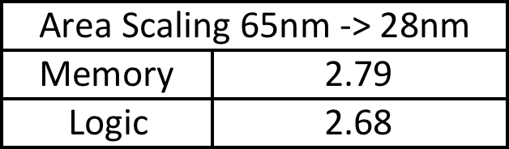
Power/Area Scaling assumptions
Scaling based on synthesizing representative block at 28nm and 65nm
Designed using 65nm library, 28nm is target technology
Area
Power

Slide 49
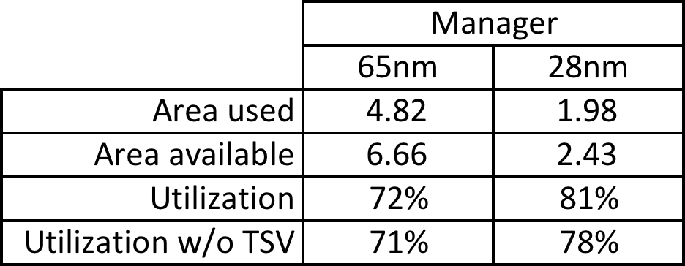
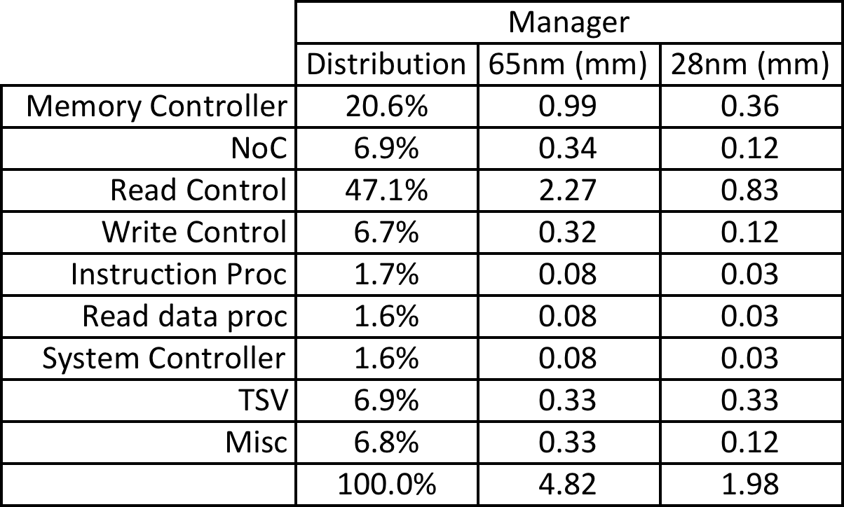
Manager AREA
Blocks
Utilization

Slide 50
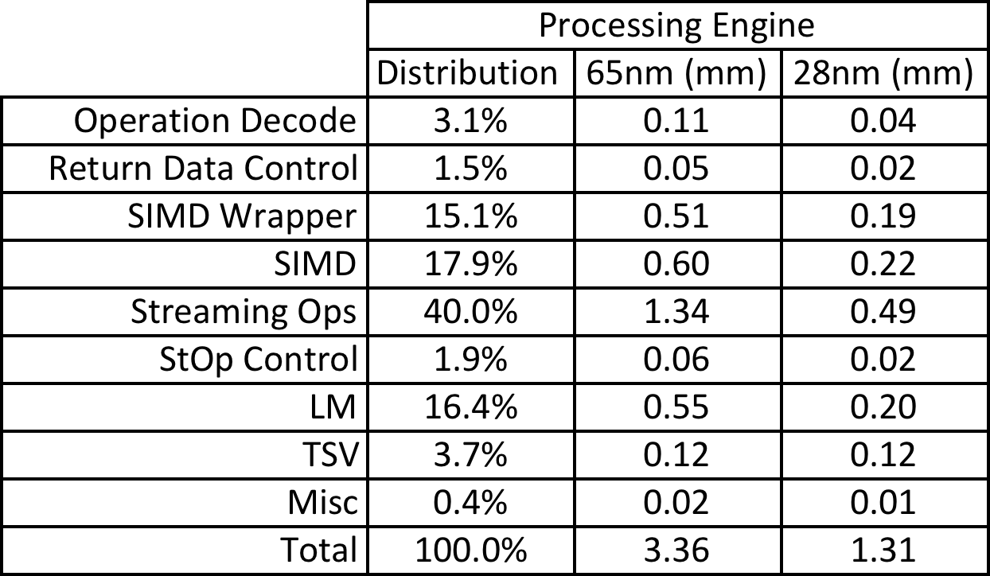
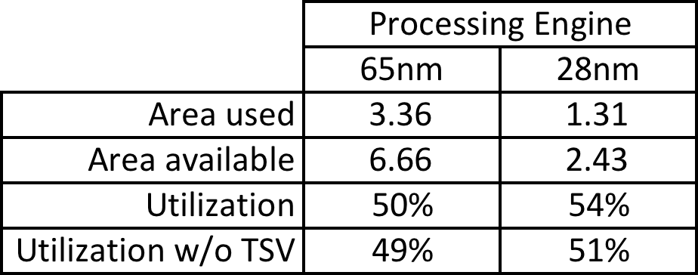
PE AREA
Blocks
Utilization

Slide 51
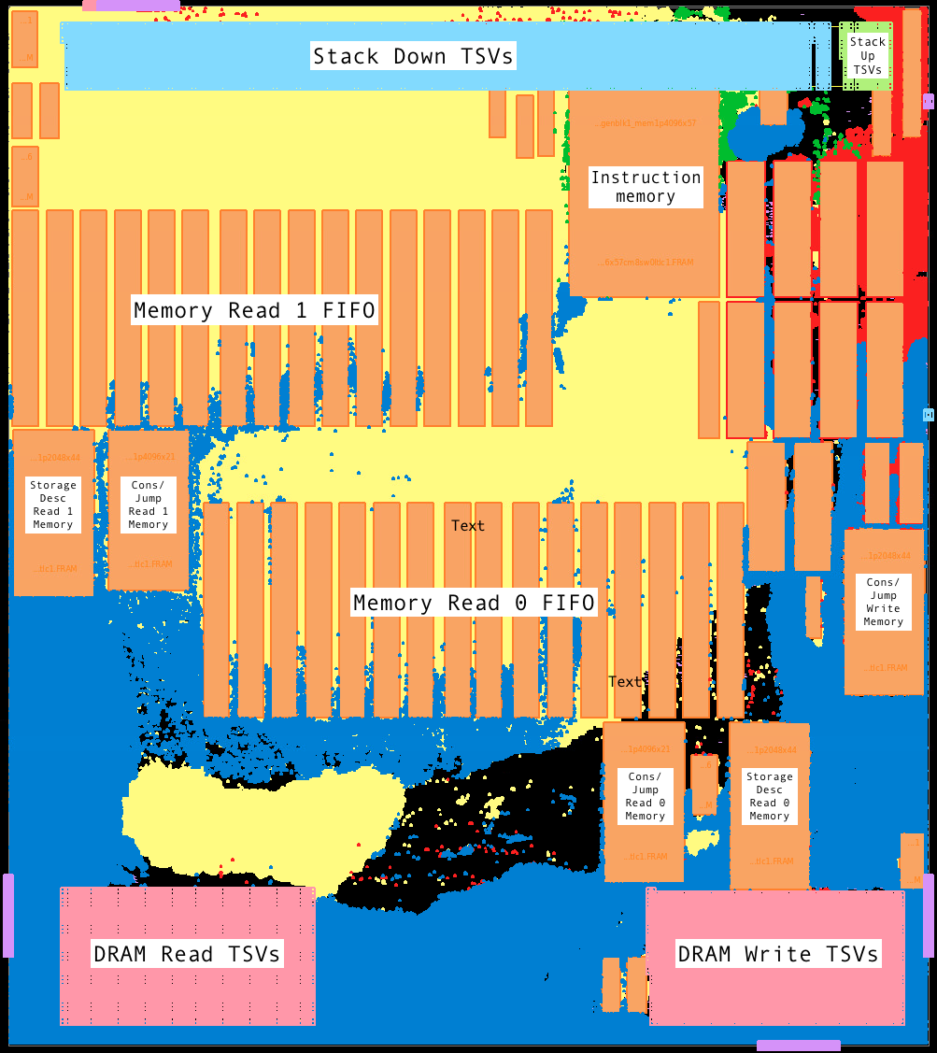
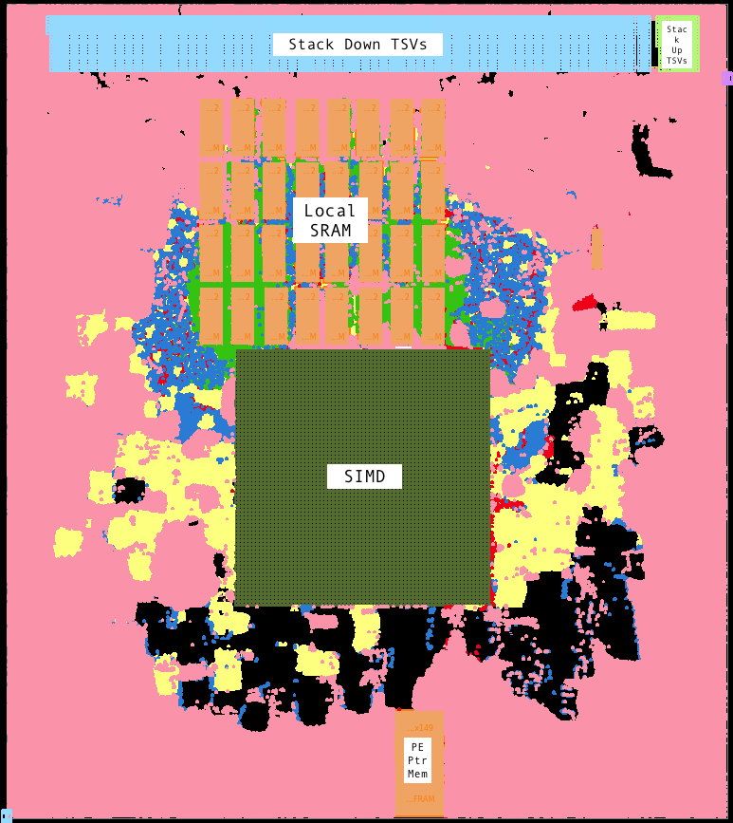
Area placement study
Placed and routed without DRC or LVS
Routing congestion showed minimal hotspots
Parasitics used in Primetime for power analysis

Slide 52
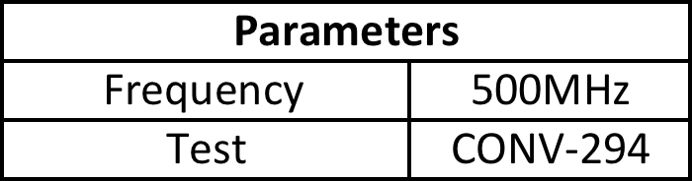
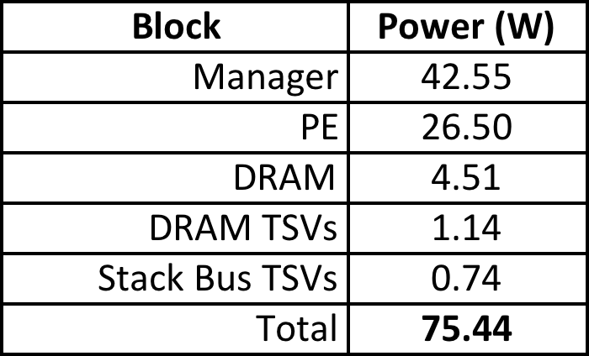
Power Summary
Power estimates based on CONV-294 testcase simulation
back to back operations
accumulate DRAM access and use DiRAM4 datasheet [14]
TSV capacitance from [4]
parasitics from layout
designed using 65nm library
28nm is target technology
power and area scaling based on synthesizing representative blocks
Notes:
back to back operations
accumulate DRAM access and use DiRAM4 datasheet
TSV energy from

Slide 53
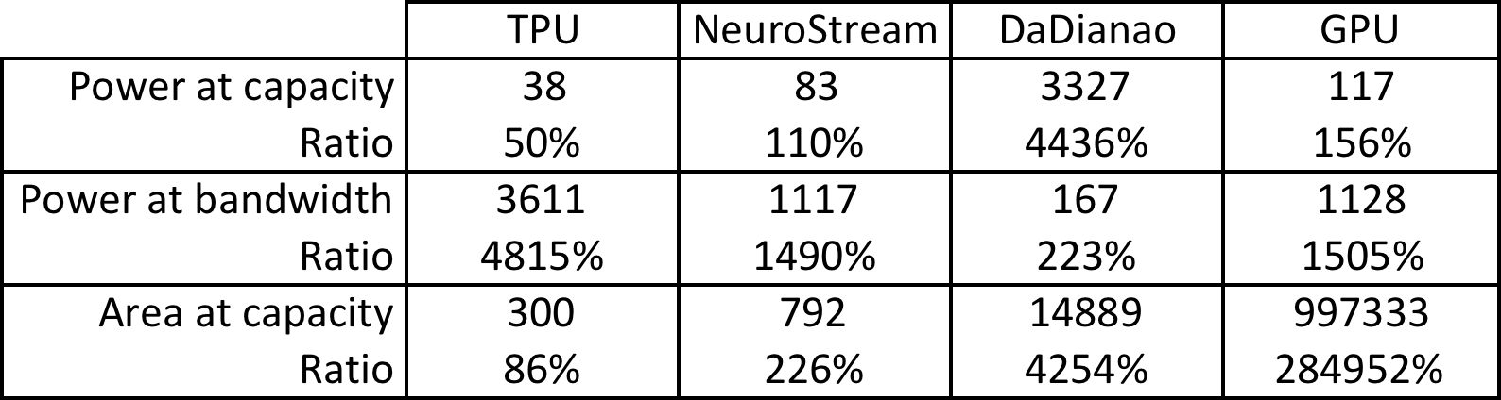
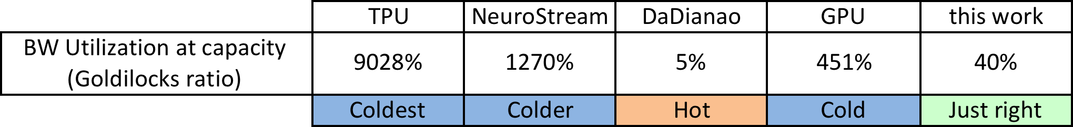
Comparison
Best comparison is to NeuroStream and DaDianNao
Goldilocks ratio
Scaled

Slide 54
Summary
Real world applications will require multiple artificial neural networks
current solutions consume significant power and real-estate
A 3DIC solution that includes:
A proposed custom 3D-DRAM
Instructions and data structures
Purpose designed functions to accelerate a Artificial Neural Networks
Architecture to take advantage of 3D technology
Overall area and power improvement
Notes:
That concludes my presentation.
Thank you

Slide 55
Publication(s)
Multi-ANN Edge System based on a Custom 3DIC DRAM - submitted to IEEE journal on emerging technologies and selected topics
Using a 2-D Laser Scanner along with Cogent Confabulation as a Localized Navigation Aid - still trying to find an appropriate journal

Slide 56
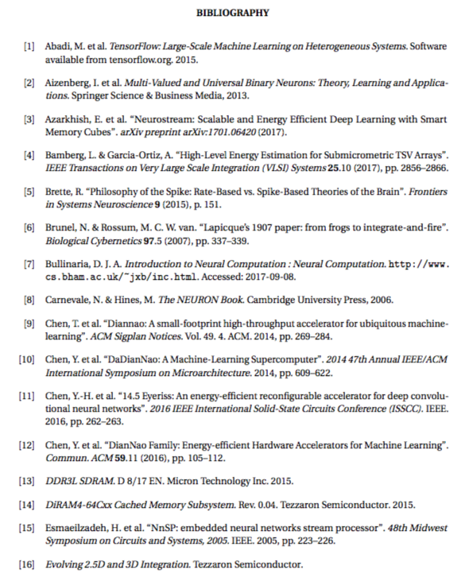
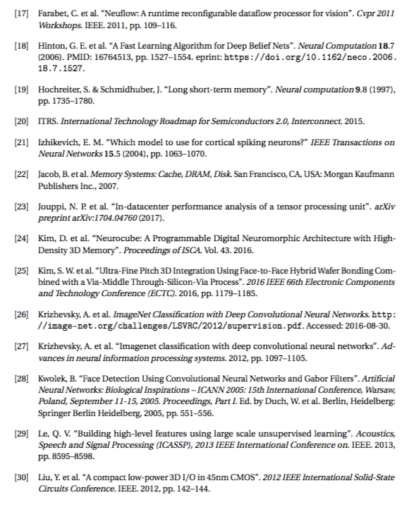
References

Slide 57
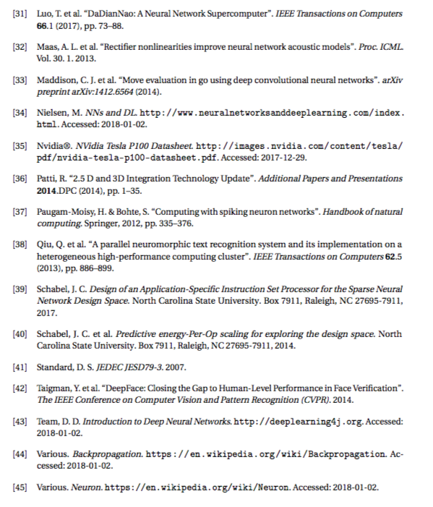
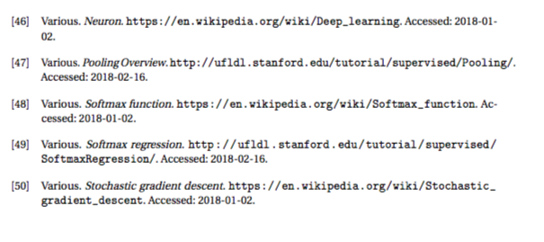
References

Slide 58
Backup

Slide 59
Discrimination
Linear
Complex

Slide 60
Artificial Neural Networks Rate-based
Output of neuron is fixed value
Multiple layers of neurons
Outputs of each layer feeds next layer
Information stored in connection weights
Output of network is class probability or a value
Notes:
Keep concise
Mention ReLu function

Slide 61
Manager Layer
Decodes instructions
sub-descriptors are sent to dependent blocks
Reads and writes to main memory
Communicates to host and other SSCs
Notes:
StreamingOps can also designed to operate on data from registers (or small local memory)
many ANN’s share a common kernel (CNNs) or operate on same input ROI
in some cases, storing the kernel or ROI in local memory may avoid unnecessary DRAM reads and IO energy
first convolution could be performed on kernel streamed from DRAM and further convolutions use local memory for one of the arguments
on PE the objective will be to maintain low ratio of local memory to processing
May consider small cache on Controller layer although this will still consume Stack bus TSV power

Slide 62
Feature kernels

Slide 63
Processing (PE) Layer
Streaming operations operate on data directly from the Stack bus
MAC, Multiply
SIMD Wrapper performs post stOp tasks
add/divide/exponent, sends result back to manager
Notes:
StreamingOps can also designed to operate on data from registers (or small local memory)
many ANN’s share a common kernel (CNNs) or operate on same input ROI
in some cases, storing the kernel or ROI in local memory may avoid unnecessary DRAM reads and IO energy
first convolution could be performed on kernel streamed from DRAM and further convolutions use local memory for one of the arguments
on PE the objective will be to maintain low ratio of local memory to processing
May consider small cache on Controller layer although this will still consume Stack bus TSV power

Slide 64
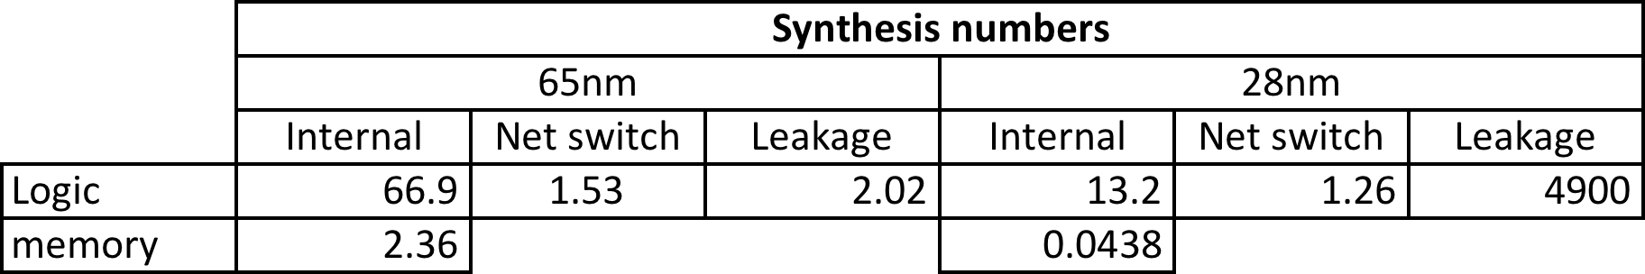
Power/Area Scaling assumptions
Scaling based on synthesizing representative block at 28nm and 65nm
designed using 65nm library
28nm is target technology

Slide 65
DRAM and Stack Buses

Slide 66
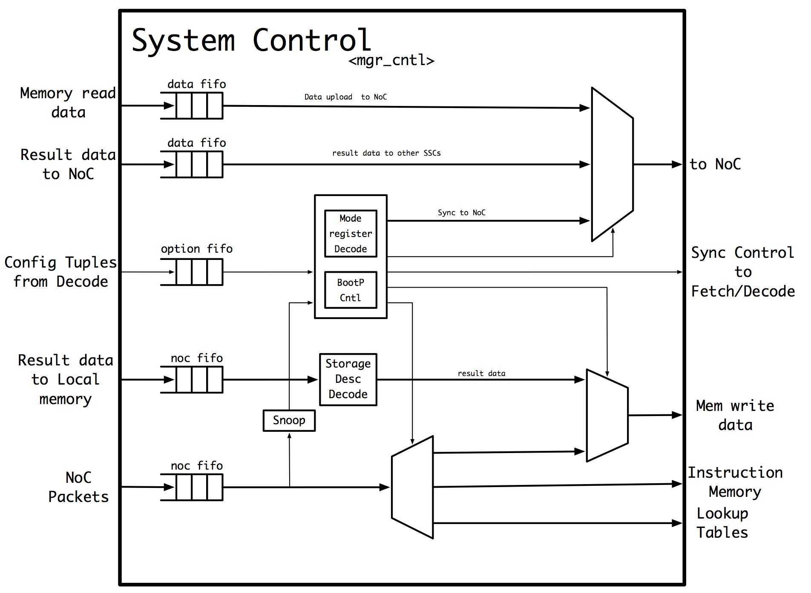
Manager Controller

Slide 67
MRC

Slide 68
RDP

Slide 69
MWC

Slide 70
PE Controller

Slide 71
SIMD Wrapper

Slide 72
Streaming Operations

Slide 73
Classifier Implementation
Separate into sub-layers

Slide 74
Classifier Implementation
Additional processing absorbed by layer l ANe MAC operation

Slide 75
Pooling Implementation
Pooling performed by ordering previous layers calculation

Slide 76
Example DRAM Access Sequence

Slide 77
Example Image Recognition CNN
Example taken from Krizhevsky, Sutsever, Hinton 2012 ^{[Kri12]}
Seven layers but only first 3 layers shown
~60M parameters(~2Gb), ~2GFLOP

Slide 78
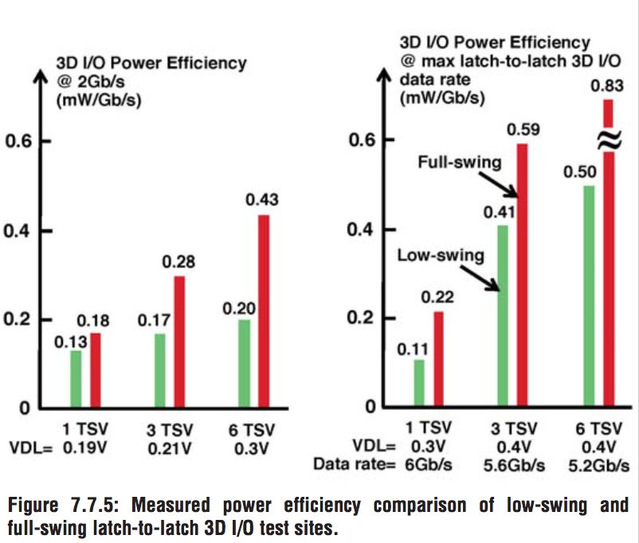
TSV Power
from [Liu12]

Slide 79
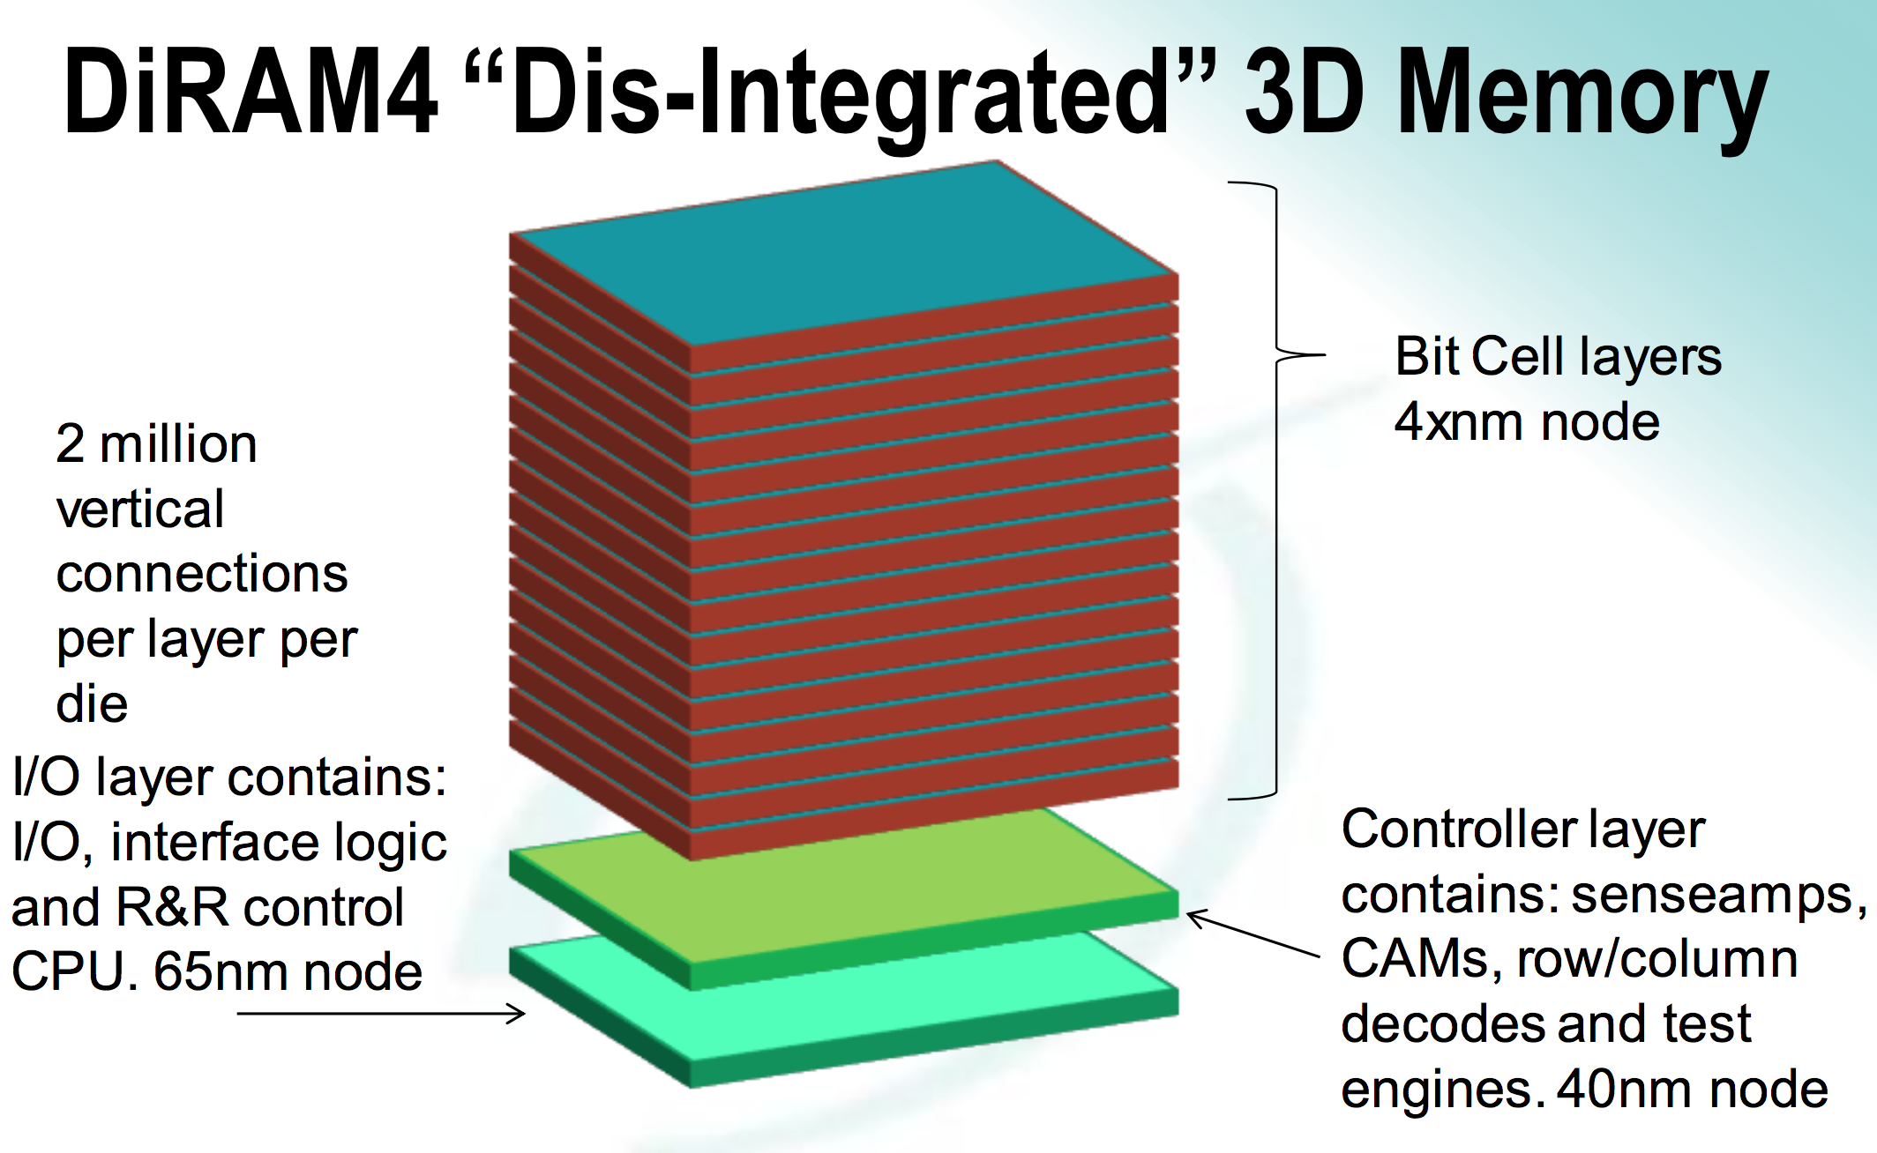
DiRAM4 Stack
from [Pat14]

Slide 80
FMA Power/Area Estimate
Consider an FMA running at the Stack bus speed of ~1GHz, from [GH11] table 1

Slide 81
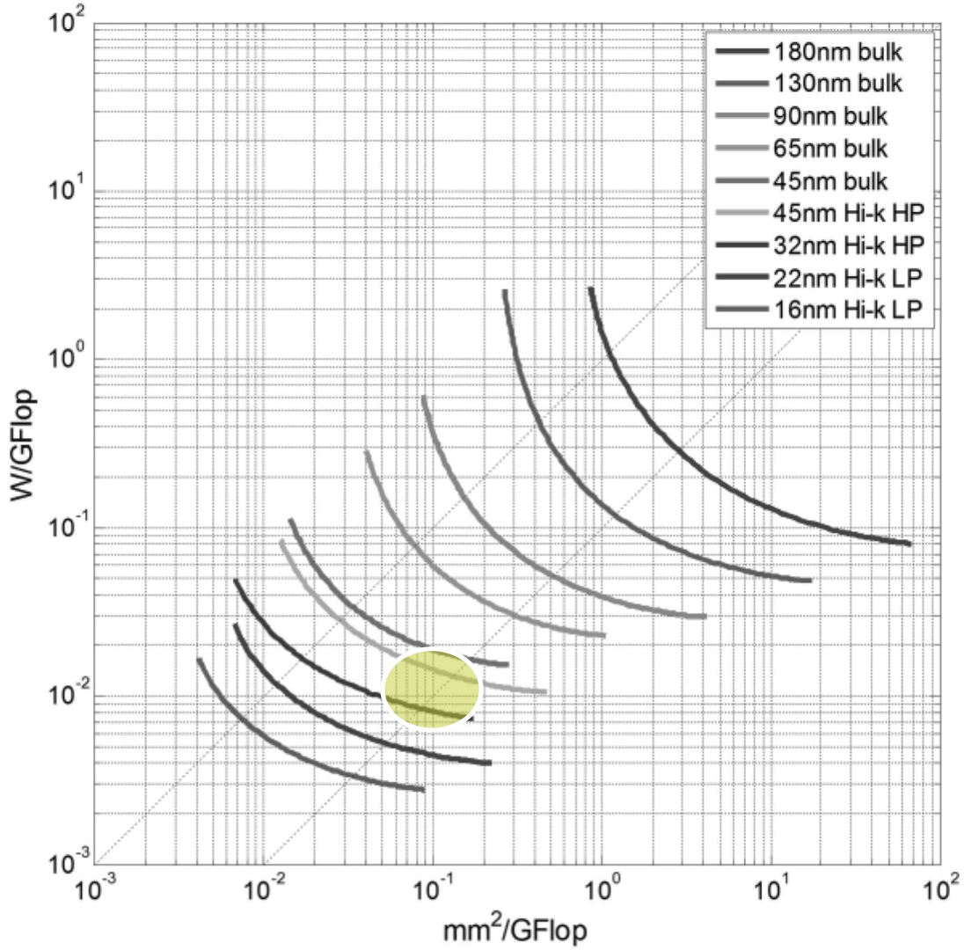
FMA Power/Area Estimate
From [GH11] figure 10 scaling from 45nm to 32nm whilst maintaining the mm²/Gflop suggests a scaling factor of 0.53

Slide 82
TSV Area
Power Delivery
~2000TSV’s ~0.1mm²
Stack Bus
2737 signals
Assume 2:1 for GND/VCC ~ 5500 TSV’s
5um pitch ~ 0.14mm²/PE
8.8mm² for 64 PE’s
DRAM Bus
4255 signals ~ 8500 TSV’s
13.6mm² for 64 Ports

Slide 83
State of the Art Older ASIC’s
NeuroCube¹
uses HMC 3D-DRAM but dependence on SRAM limits support to CNNs
Eyeriss²
discusses DRAM accesses but their focus is on the convolution operation
supports CNN convolution operation only
NnSP³
uses cache between DRAM and 8Mb SRAM and will be limited by DRAM bandwidth
does not discuss multi-devices
Neuflow⁴
limits their support to CNNs and in the case of Eyeriss only supports the convolution
will not support locally-connected ANNs
Notes:
What measure would you use?

Slide 84
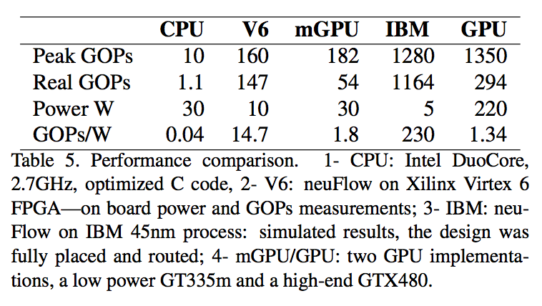
State of the Art GPU’s
GPU’s target the general market and employ infrastructures not necessary for NN implementation
we associate power of GPU solution ~100-200W
Will still be limited by memory bandwidth although they are starting to utilize 3D-DRAM
general purpose architecture makes it hard/impossible to make full use of theoretical performance
[Far11]

Slide 85
Detailed Block Diagram

